Slide 1

ACADEMIC PROJECT • 2026
Food Waste Analysis
and Economic Loss
Prediction
Data Analytics & Machine Learning Project
NTI X ITIDA Advanced Data Analytics Internship
Aya Khaled
Jana Mohamed
Maha Gad
2026-08-29

Slide 2
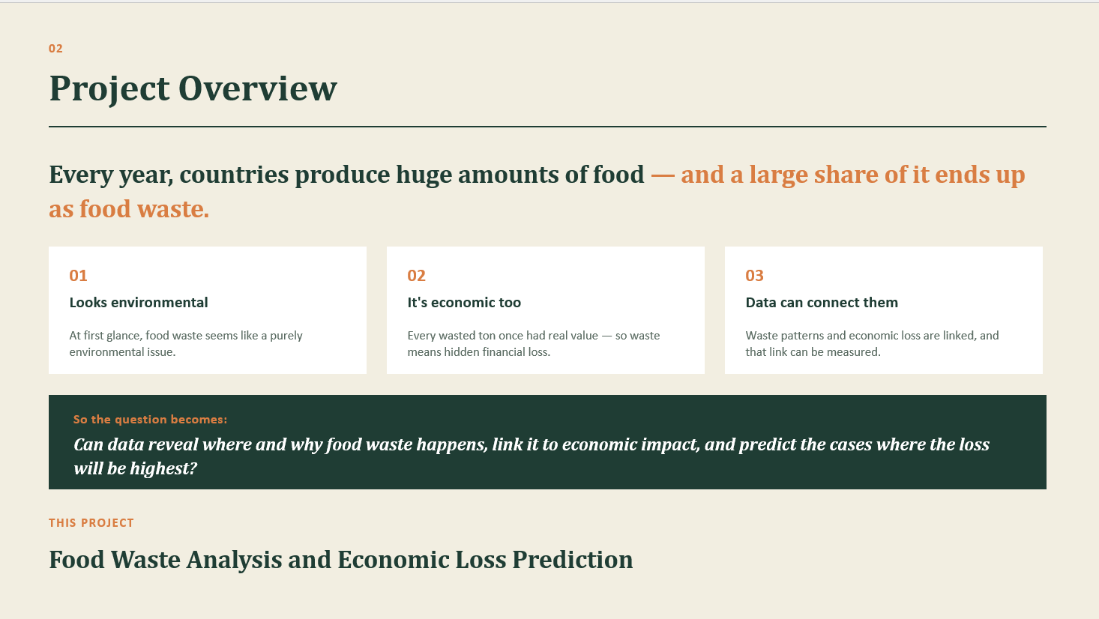

Slide 3
03
Dataset
Country
Year
Food Category
PREDICTION TARGET
GEOGRAPHY
TIME
CATEGORY
Economic Loss
Total Waste (Tons)
Avg Waste per Capita (Kg)
Population (Million)
VOLUME
INTENSITY
SCALE
Million $
Household Waste (%)
What financial impact should we expect?
SHARE

Slide 4
04
Exploratory Data Analysis
5
Population
12% missing
columns contained missing values
Household Waste
10% missing
✓ No duplicate rows
✓ No invalid negative values
✓ No IQR outliers detected
Other columns
6% missing
PROFILE → VALIDATE → VISUALIZE → INTERPRET

Slide 5
05
Data Cleaning
Population
Median by Country + Year
Total Waste
Median by Country + Food Category
Avg Waste per Capita
Median by Country + Food Category
Household Waste
Median by Country
Food Category
Mode
FALLBACK • GLOBAL MEDIAN

Slide 6
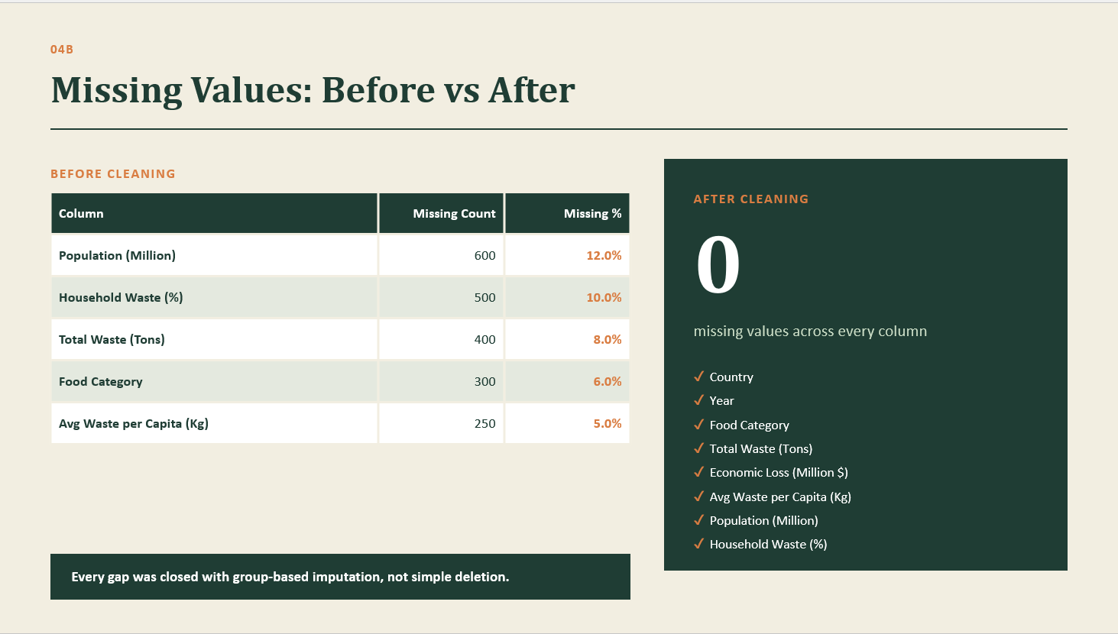

Slide 7
06
Leakage-Safe ML Preparation
RAW DATA
TRAIN / TEST
IMPUTE
MODEL
Complete feature set
Split first
Training values only
Fit & evaluate
“Train data was used to calculate imputation values to prevent Data Leakage.”

Slide 8
07
Power BI Dashboard
From analysis to action.
Food Waste Analysis Dashboard
Common Features
KPIs: Total Population | Total Economic Loss ($) | Average Individual Food Waste (kg) | Total Food Waste (Tons)
Slicers: Year | Country | Food Category
Navigation: Waste Overview | Country Analysis | Map
Page 1 — Waste Overview
Household Food Waste (%) — Gauge
Economic Loss ($) by Year — Area Line Chart
Food Waste (Tons) by Year — Area Line Chart
Food Waste (Tons) by Category — Funnel Chart
Page 2 — Country Analysis
Top 10 Countries by Food Waste (Tons)
Top 10 Countries by Economic Loss ($)
Top 10 Countries by Household Food Waste (%)
Top 10 Countries by Individual Food Waste (Kg)
Page 3 — Map
Economic Loss by Country — Map

Slide 9
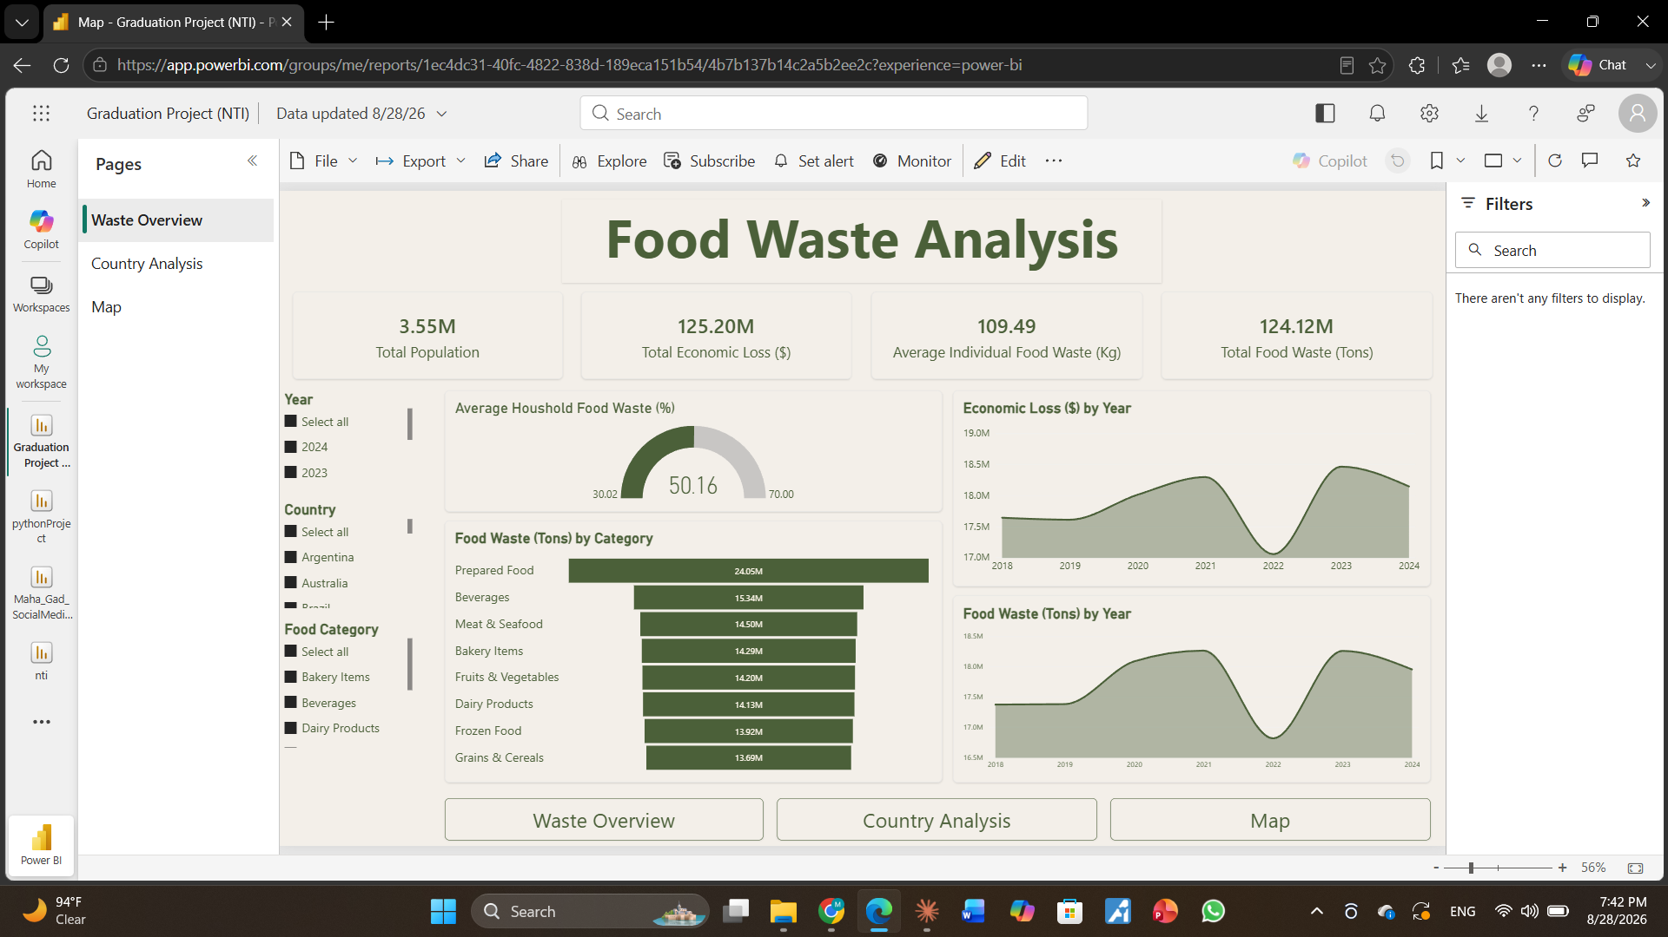
07
Power BI Dashboard

Slide 10
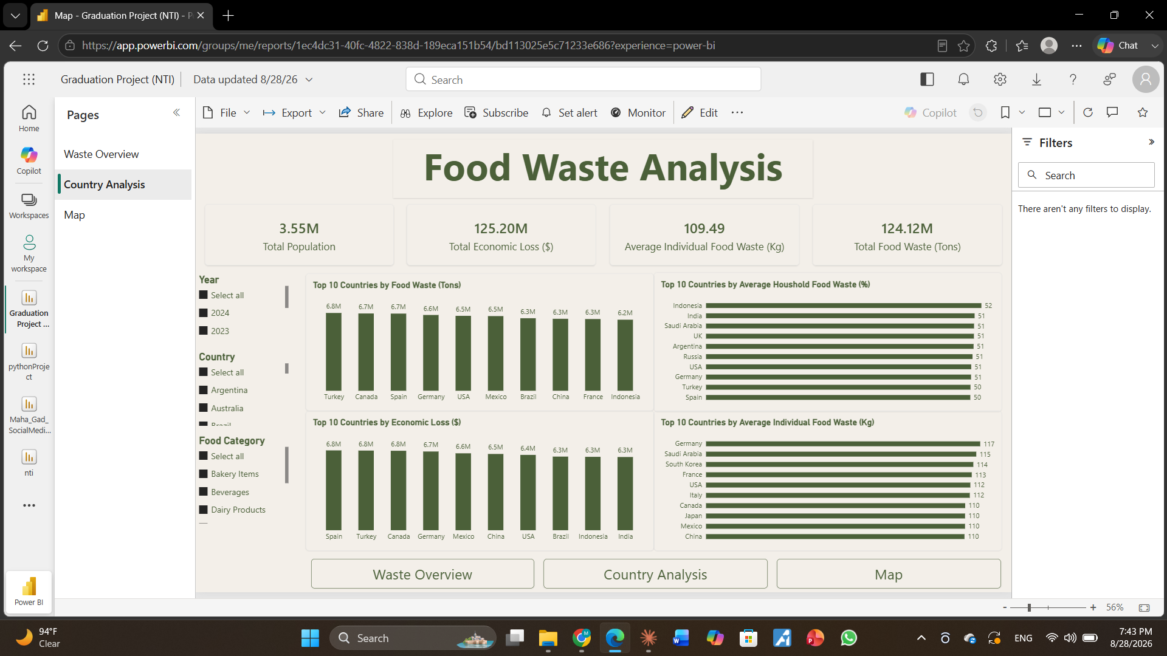
07
Power BI Dashboard

Slide 11
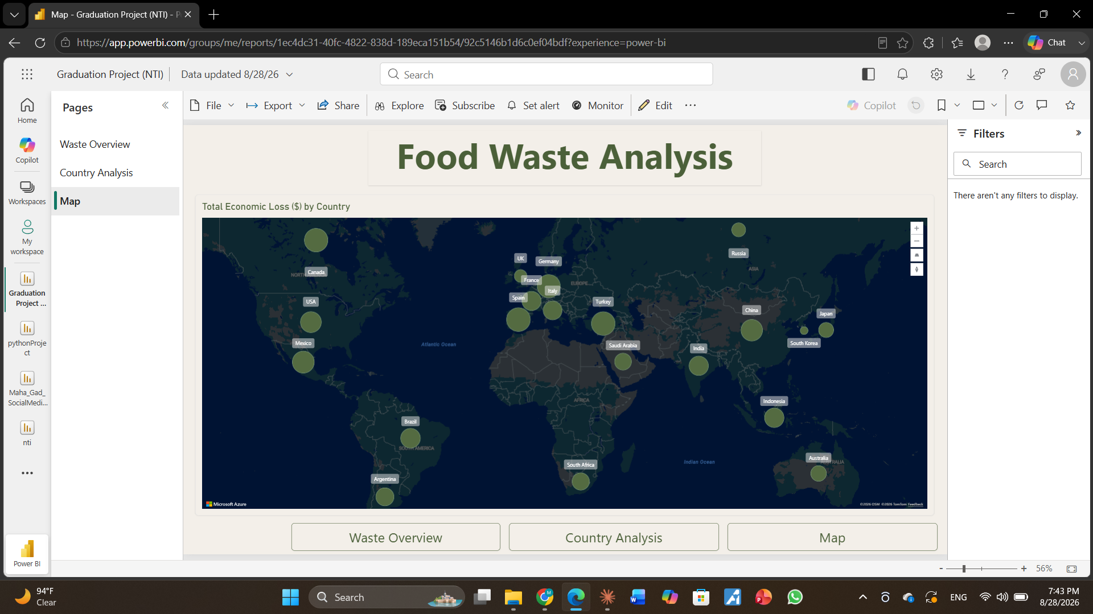
07
Power BI Dashboard

Slide 12
07
Power BI Dashboard
From analysis to action.
Key Insights
Prepared food recorded the highest level of food waste among the categories analyzed.
Households contributed an average of 50% of food waste, with values ranging from 30% to 70%.
2022 recorded the lowest food waste and economic loss during the 2018–2024 period.
Food waste represents both a food-resource problem and a significant economic loss.
Recommendations
Reduce prepared-food waste through better portion planning, storage, and leftover reuse.
Target household waste through meal planning, smarter shopping, and food-storage awareness.
Investigate the factors behind the 2022 decline and identify practices that could be maintained.
Treat waste reduction as a cost-saving opportunity by focusing on the food categories generating the most waste.

Slide 13
08
Linear Regression
How much economic loss is expected?
MAE
6,734.72
Predicts the actual numerical value of Economic Loss (Million $).
MSE
106,144,200.55
RMSE
10,302.63
53.32%
R² • explained variance

Slide 14
10
Logistic Regression
INPUT FEATURES
LOGISTIC MODEL
PROBABILITY
CLASS
Waste • population • category
Estimate class probability
0.00 → 1.00
0 Low / 1 High
Classification answers which level — not the exact loss amount.

Slide 15
09
Creating the Classification Target
No binary target existed in the original dataset — so loss level was engineered from the training median.
y_train.median()
0 LOW LOSS
<
1 HIGH LOSS
>=
TRAINING MEDIAN
Median calculated on training data only → no leakage

Slide 16
11
Model Comparison
LINEAR REGRESSION
LOGISTIC REGRESSION
How much?
Which level?
Predict exact Economic Loss
Classify Economic Loss level
Continuous numerical value
0 = Low / 1 = High

Slide 17
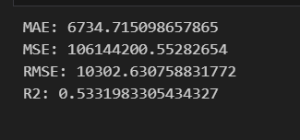
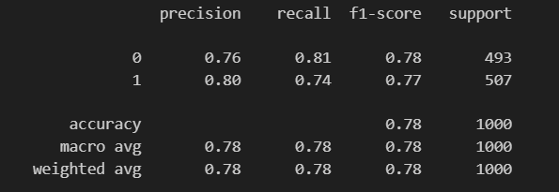
11
Model Comparison
LINEAR REGRESSION
LOGISTIC REGRESSION

Slide 18
Links
Link Deployment
Link Image Project in Docker Hub

Slide 19
12
Conclusion
01
UNDERSTAND
EDA exposed quality issues and meaningful patterns.
02
PRESERVE
Group-based imputation retained data relationships.
03
PROTECT
Training-only preprocessing prevented leakage.
04
PREDICT
Regression estimated loss; classification assigned level.
05
ACT
Power BI turned analysis into interactive intelligence.
Data-driven decisions can support more sustainable food systems.

Slide 20
QUESTIONS & DISCUSSION
Thank
You
Food Waste Analysis and Economic Loss Prediction
2026-08-29

